Slide 1
GAM320 - Creativity & Prototyping
Brian McDonald

Slide 2
The Problem

Slide 4

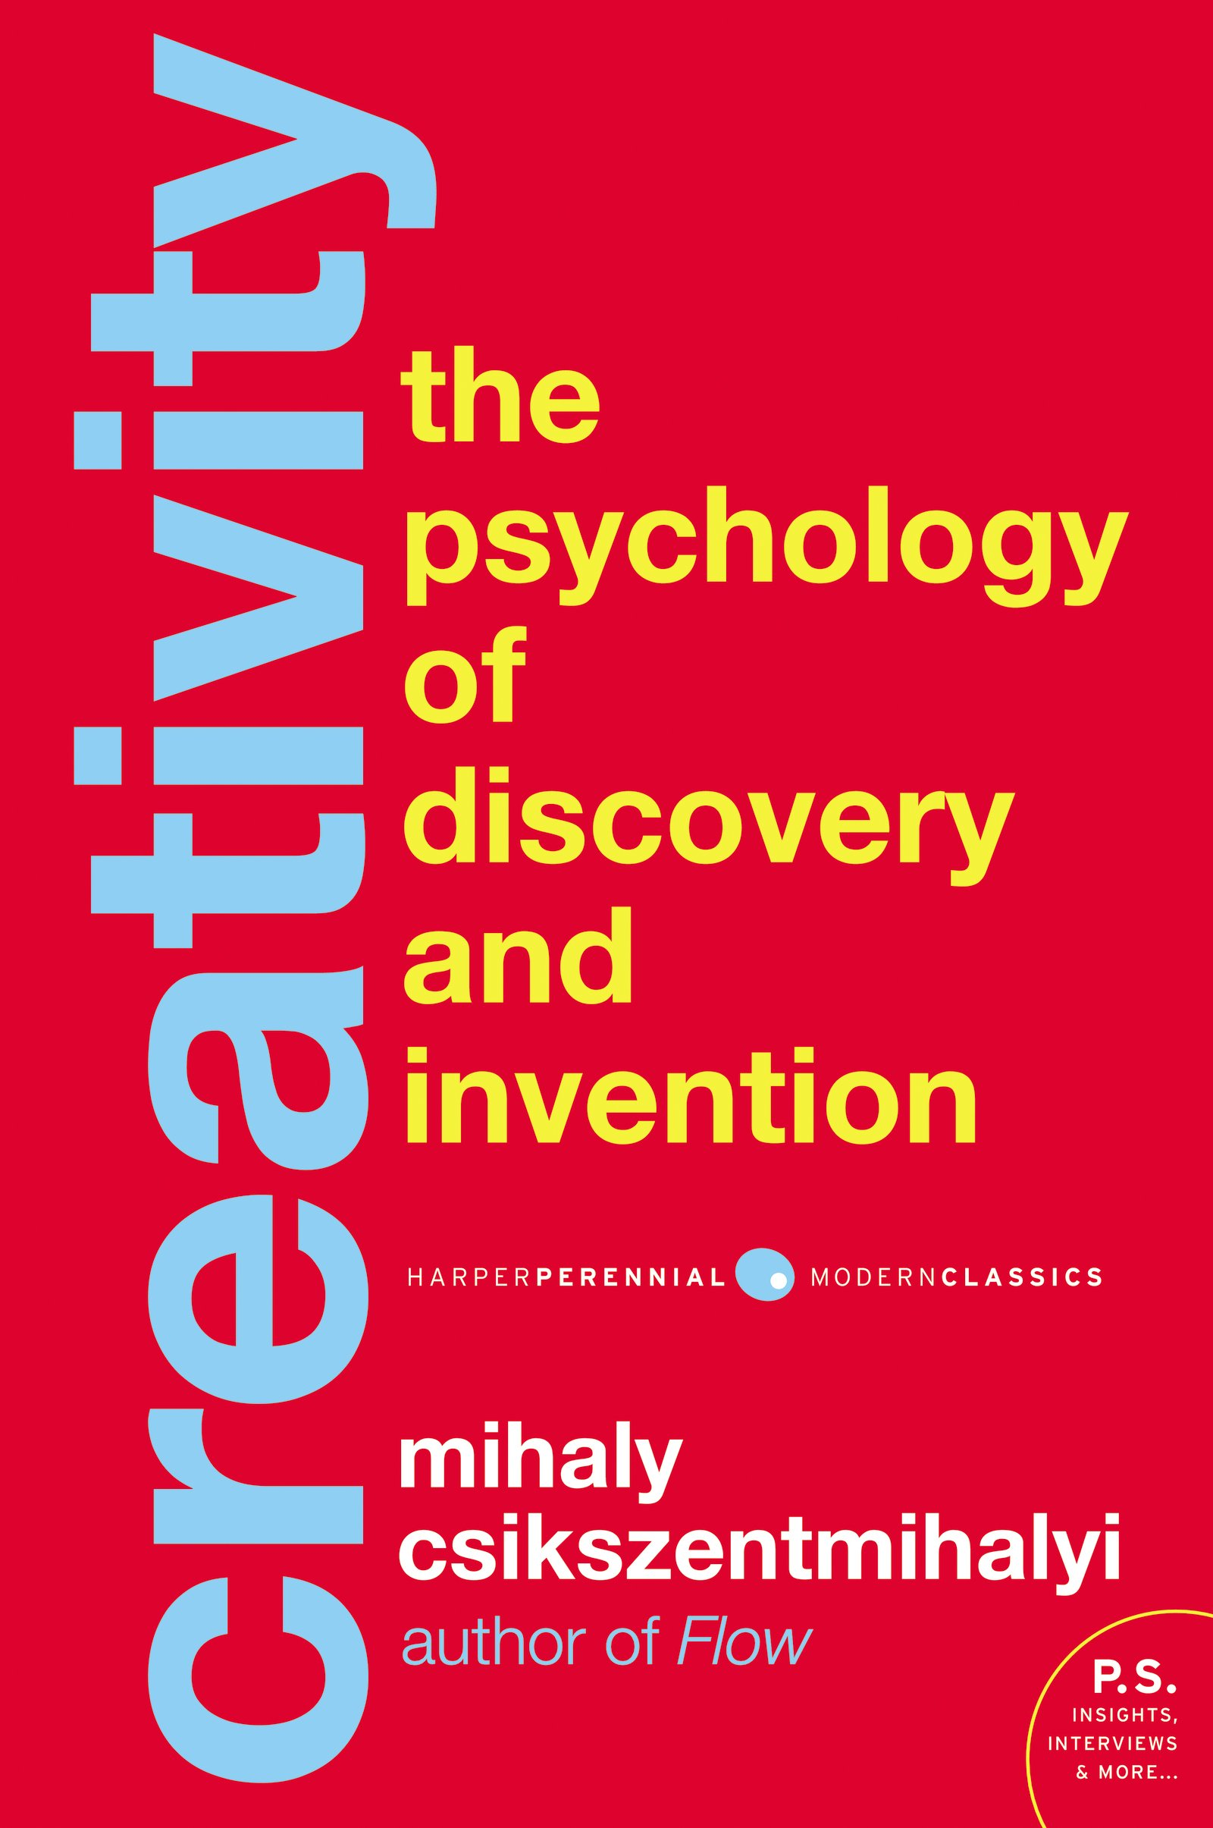

Models of Creativity

Slide 5
Models of Creativity
Wallas Model
Preparation
Incubation
Illumination
Verification
Notes:
http://members.optusnet.com.au/charles57/Creative/Brain/wallis.htm 1. In the preparation stage, we define the problem, need, or desire, and gather any information the solution or response needs to account for, and set up criteria for verifying the solution's acceptability.
2. In the incubation stage, we step back from the problem and let our minds contemplate and work it through. Like preparation, incubation can last minutes, weeks, even years.
3. In the illumination stage, ideas arise from the mind to provide the basis of a creative response. These ideas can be pieces of the whole or the whole itself, i.e. seeing the entire concept or entity all at once. Unlike the other stages, illumination is often very brief, involving a tremendous rush of insights within a few minutes or hours.
4. In verification, the final stage, one carries out activities to demonstrate whether or not what emerged in illumination satisfies the need and the criteria defined in the preparation stage.

Slide 6
Models of Creativity
Wallas
Preparation
Incubation
Illumination
Verification
Csikszentmihalyi
Preparation
Incubation
Insight
Evaluation
Elaboration
Notes:
Chapter 6 - Game Design Workshop
Preparation: Become immersed in the topic
Incubation: Churn around the idea
Insight: Aha moment, idea falls together
Evaluation: Check to see if the insight was valuable and worth exploring
Elaboration: Longest part of the process

Slide 7
Models of Creativity
Wallas
Preparation
Incubation
Illumination
Verification
Csikszentmihalyi
Preparation
Incubation
Insight
Evaluation
Elaboration
Petty (ICEDIP)
Inspiration
Clarification
Evaluation
Distillation
Incubation
Perspiration
Notes:
Inspiration – explore, generate ideas, research, have visions, brainstorm, dream!
Clarification – discuss aims, clarify goals, research costs, assess risks
Evaluation – assess which ideas have the best potential, and how to improve your work as it moves forwards. Find Strengths & weaknesses - how to capitalize and remove.
Distillation - the process of concentrating your ideas into a single vision.
Incubation - Leaving the work alone, allowing it to stay on the surface of your mind. Stopping and working on other things.
Perspiration - Determined, hard work on only your best ideas. Draft, evaluate, redraft.

Slide 8
Practical Advice

Slide 9
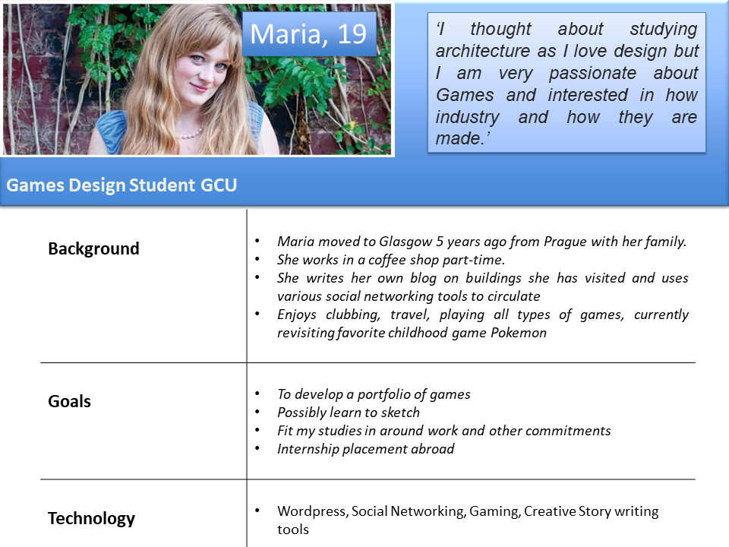
Know your audience - Personas
Notes:
Once you have an audience identified, build a persona. https://www.interaction-design.org/literature/book/the-encyclopedia-of-human-computer-interaction-2nd-ed/personas You build 1 to N number of personas and they often contain bio info (likes, dislikes), a bit of flavour.

Slide 10
Ideation - Brainstorming
Notes:
State a challenge
No Criticism
Vary the Method
Playful Environment
Put it on the Wall
Go for lots of ideas
Don’t go to long

Slide 11
Brainstroming methods - List Creation
Write out everything you can think of in a topic
Process of writing them down helps you freely associate and organise
Excellent for groups, gets everyone on the same page

Slide 12
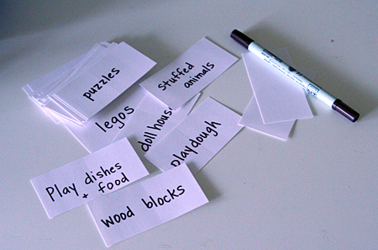
Brainstroming methods - Idea Cards
Brings an element of randomness into the mix
Take a deck of index cards, write a word on each one
Shuffle them up, take two cards out and pair them

Slide 13
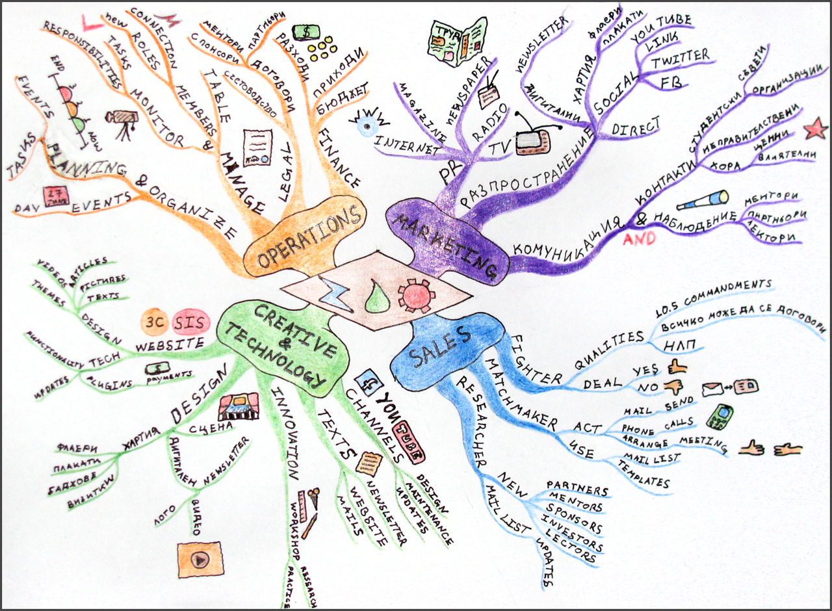
Brainstroming methods - Mind Maps
Visual method to explore ideas visually
Start with a core idea and build linkages with connect ideas
Aids in pulling together a shared vocabulary about the game

Slide 14
Brainstroming methods - Stream of Conscious/Shout out
Often better for individuals
Sit down at a computer (or pen and paper), start writing anything that comes to mind for 10 mins.
Shout Out is very similar, use a voice recorder and speak for 10 mins. Then go back and transcribe.

Slide 15

Brainstroming methods - Cut it Up
Take a newspaper or magazine, go to any page, and cut random words and images
Once you have a pile pieces, start playing with them, match them up to make game concepts.

Slide 16

Brainstroming methods - Research
Useful for serious games and games that are grounded in a world
Research a topic that interests you. Immersive yourself in a topic
Even if your game isn’t ground in the real world it might have real world analogues

Slide 17
The role of constraints
At the Academy, you only have a few constraints
Time (deadlines)
Technology
Skillset
Team makeup
Constraints are drivers for creativity, consider adding them into your project
Audience - The game should appeal to your Mother
Technology - Mobile game
Interaction - the game only uses one button
Notes:
Constraints are requirements and limitations we have to address in order to reach our goal

Slide 18
Prototyping

Slide 19
Prototyping
The goal of a prototype is to answer some questions about your game or an approach
It should be quick to develop, rough in terms of quality and be ‘throw away’
You may have several prototype idea, consider splitting your team
Prototype 1 - Combat System
1 Programmer
1 Designer/Lead
1 Artist
1 Animator
Prototype 2 - Crafting System
2 Programmer
1 Designer/Lead
1 Artist
1 Wrtiter

Slide 20
Prototyping tips
Prototyping is not Pre-Production, in pre-pro you know what the game is going to be
It is fine to fail, failure is part of the process
Use previously created assets, greyboxes, basic shapes
Test, Test, Test!
Timebox everything
2 weeks per prototype
⅓ of development time on prototypes
Make prototypes on the tools you feel most comfortable with

Slide 21
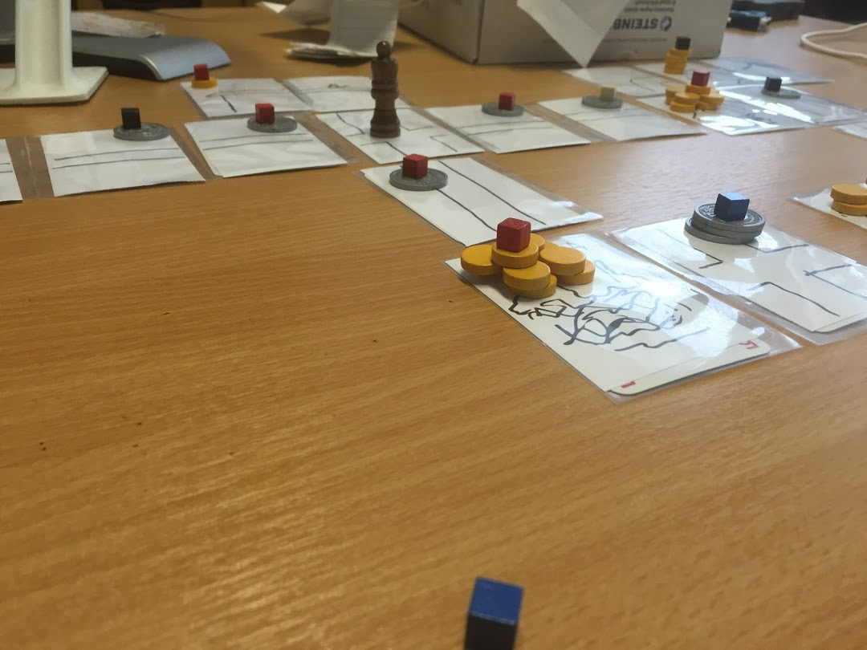
Paper Prototypes
Notes:
Tools
Sheets of paper
Dice
Cards with card sleves
Post it notes
Boardgame bits
Best uses
Space, maps, grids
GUI
Simple systems (probabilities, weapons etc)

Slide 22
Paper Prototypes
Advantages
Speed of development and iteration
Low barrier to entry
Collaborative
Iterative by nature
Disadvantages
Tracking lots of information
Physical interfaces
Game rhythm issues

Slide 23
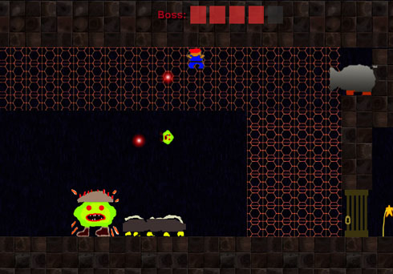
Digital Prototypes
Spiderman PS4 - https://twitter.com/KrisZadziuk/status/1039858710460473344

Slide 24
Digital Prototypes
Mechanics
Aesthetics
Storyboards
Concept art
Animatic
Interfaces
Audio
Kinesthetics
Game Feel
Controls

Slide 25
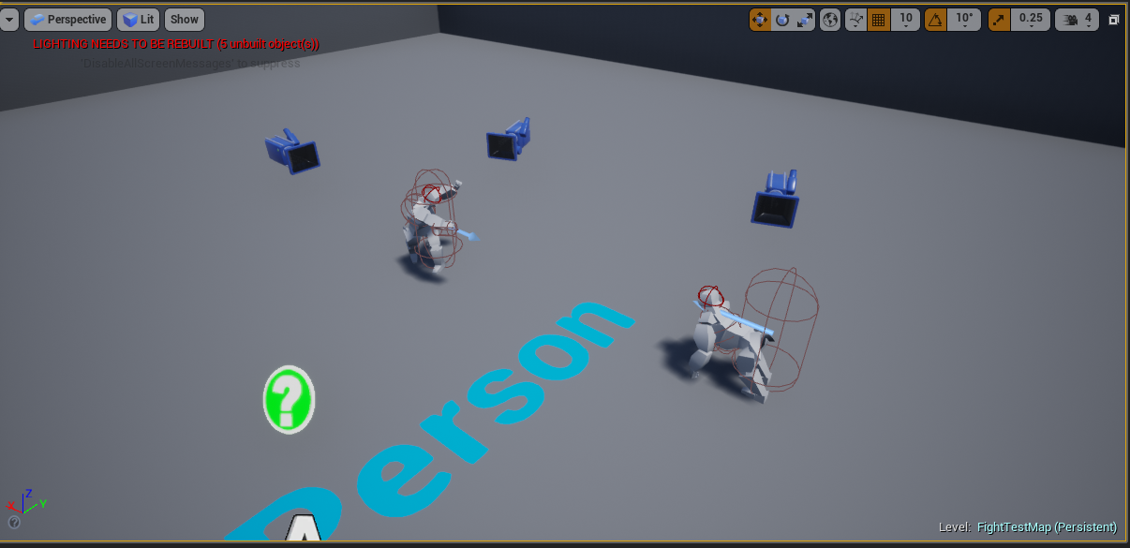
Case Study

Slide 26


Team
Me!
Programmer/Designer
Richard Milligan
Artist/Animator/Designer

Slide 27
The Game
Fighting game which uses direct movement of the joypad thumbsticks to control the arms of the combatants
Theme - male Gorillas fighting for dominance
3 Initial prototypes
Movement
Combat
Switching between combat and movement

Slide 28
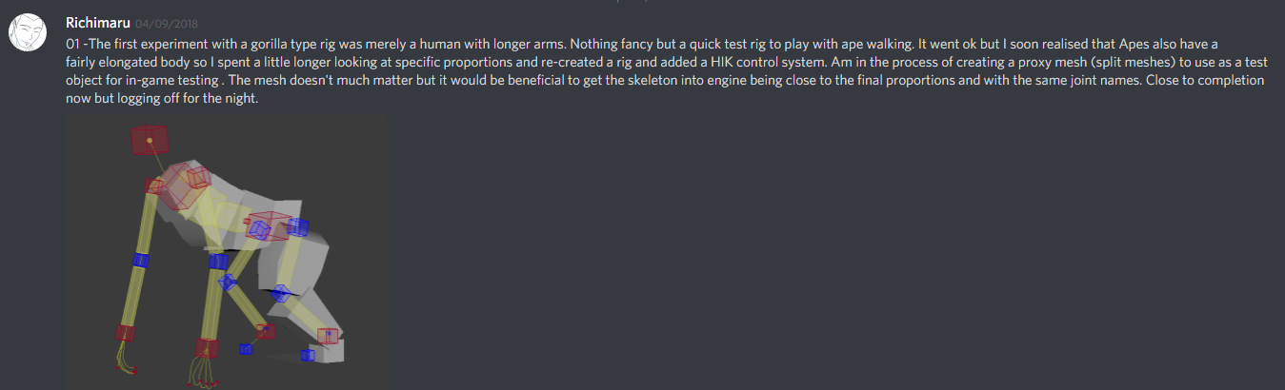
Task 01 - Art/Animation - Proxy Mesh/Rig
Reference - https://www.youtube.com/watch?v=3T0z1CT-nR8

Slide 29
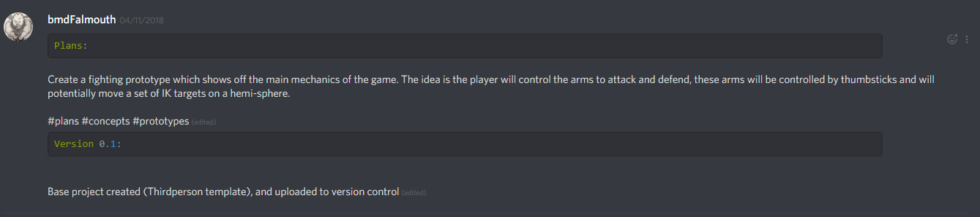
Task 02 - Start of Movement Prototype

Slide 30
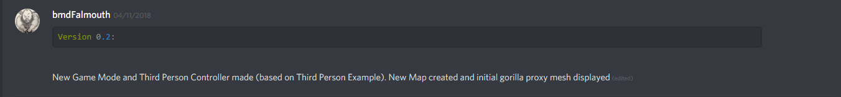
Task 03 - Movement

Slide 31
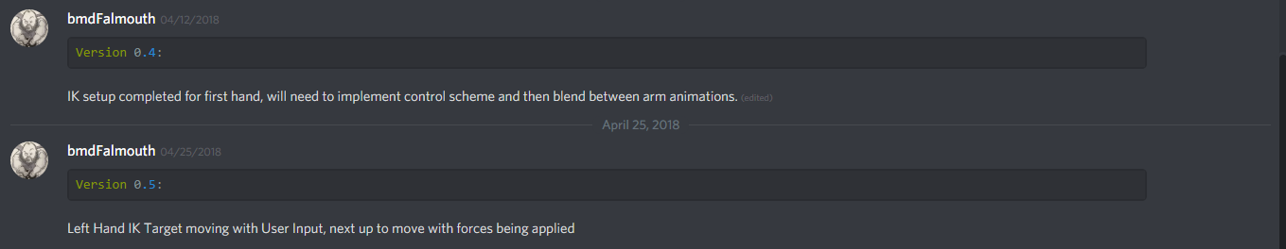
Task 04 - IK Combat System

Slide 32
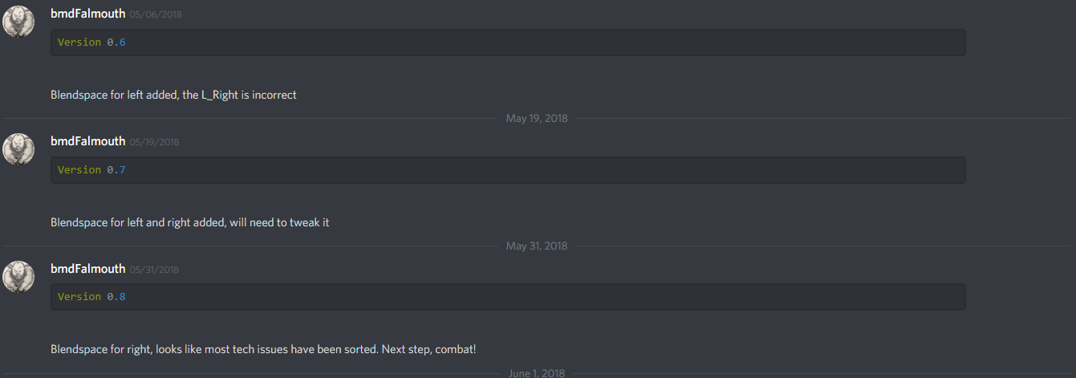
Task 05 - Move to Blendspaces for combat

Slide 33
Task 05 - Move to Blendspaces for combat

Slide 34
Lessons Learned
Prototypes are a collaboration
The question we were trying to answer required
1 Programmer
2 Designers
1 Artist
1 Animator
Iteration, Iteration, Iteration!
Research is also key, animator required references
Ensure your prototypes are small

Slide 35
Closing Advice
Game Jams
Throw away your first idea
Iterate
Play and Evaluate
Kill your darlings

Slide 36
Questions?

Slide 37
References
Gibson Bond, J. Introduction to Game Design, Prototyping and Development 2nd Edition. Addison-Wesley, 2017. Chapters 15 & 28 - 35 Warfel, T.Z. Prototyping: A Practitioner’s Guide, Rosenfeld Media 2009 Fullerton, Tracy. Game Design Workshop: A Playcentric Approach to Creating Games 4th Edition. Morgan Kaufmann, 2018. Chapter 7 & 8 Dallas, I. Weaving 13 Prototypes into 1 Game: Lessons from 'Edith Finch', GDC 2018 https://www.gdcvault.com/play/1025016/Weaving-13-Prototypes-into-1 Martz, N. Perfecting Pitchable Prototypes, GDC 2012 https://www.gdcvault.com/play/1015849/Perfecting-Pitchable Glinert, E. Rapid, Iterative Prototyping Best Practices, GDC 2012 https://www.gdcvault.com/play/1015585/Rapid-Iterative-Prototyping-Best

